Slide 1
Action Generation using Graph Convolutional Networks
Deep Learning Project Presentation-1

Slide 2
Table of contents
01
02
03
04
05
Team Members:
Logesh.V (CS24M106)
Kavya Sri (CS24M111)
Shilpa Roy (CS25D002)
Problem Statement
Literature Review
Key Issues Faced
Methodologies
Results & Inference

Slide 3
Problem Statement
Design a Graph Convolutional Network (GCN)-based framework to generate realistic, kinematically valid human actions from skeleton data by modeling spatio-temporal dependencies, while integrating inverse kinematics to constrain outputs to anatomically feasible motion.

Slide 4
Motivation
Generation as a Current Trend: Generative models (e.g., GANs, VAEs) are pivotal in AI research, but skeleton-based action generation remains underexplored. GCNs align with the graph structure of skeletons, enabling efficient modeling of joint relationships, making them ideal for motion synthesis.
Speed and Efficiency of GCNs: Unlike pixel-based models (e.g., CNNs), GCNs directly process skeletal graphs, avoiding computational overhead from flattening graph data. This efficiency is critical for real-time applications like animation and gaming.
Utility of Skeleton-Based Data: Skeletons provide compact, structured representations of human motion. GCNs capture spatial dependencies between joints, making them suitable for generating animations, character rigs, or motion transfer systems.
Inverse Kinematics (IK) for Output Correction: Integrating IK allows post-hoc adjustments to generated poses, ensuring anatomical plausibility. During training, IK acts as a constraint, clamping the output space to physically valid motions, stabilizing training and improving usability.

Slide 5
Literature survey
Convolutional Sequence Generation for Skeleton-Based Action Synthesis (2019)
Authors | Sijie Yan*, Zhizhong Li*, Yuanjun Xiong, Huahan Yan, Dahua Lin
Datasets | NTU-RGB+D → A real-world action dataset with 56,000 short clips from 60 action categories. (25 joints) MikuDance → A novel dataset collected by the authors, featuring 10 hours of high-quality dancing sequences. (46 joints)
Methodology | Conv. Seq. Gen. Net. (CSGN) → Uses a Gaussian Process (GP) with RBF kernel to sample latent vectors, Spatial-Temporal Graph Convolutions, Graph Pyramid Operations like Upsampling & Spatially-Varying Convolutions, Adversarial Training using WGAN-GP^{[1]}. Bidirectional Transformation → maps observed sequences back to latent vectors, enabling conditional generation
Findings Quantitative Results: NTU-RGB+D: outperforms autoregressive (ERD, acLSTM) and GAN-based (HP-GAN) baselines. MikuDance: achieves robustness for long sequences. Ablation Studies^{[2]}: Gaussian Process: Using a spectrum of length scales (σᵢ = 0–100) improved generation quality over fixed scales. Graph Operations: Gradual upsampling and spatially-varying convolutions reduced FID^{[3]} by ~50% compared to temporal-only models. Qualitative Results: Generated sequences showed short-term smoothness and long-term diversity (e.g., 60sec dances). Failure cases included occasional unnatural poses (e.g., twisted bodies, limb intersections). |  | Improvements Done: Introduced CSGN, a non-autoregressive framework for long-sequence generation. Proposed graph pyramid operations for multi-resolution spatial-temporal modeling. Released the MikuDance dataset, addressing the lack of long-duration skeleton data. Needed Improvements: Pose Realism: Mitigate unnatural poses through better physical constraints. Generalization: Test on more diverse action categories and real-world motion capture data.
Notes:
A powerful technique for generating high-quality synthetic data using Wasserstein Generative Adversarial Networks with Gradient Penalty.
An ablation study aims to determine the contribution of a component to an AI system by removing the component, and then analyzing the resultant performance of the system.
Fr´echet Inception Distance (FID) [13], which measures the distance between the statistics of real and synthesized data on feature space.

Slide 6
2. Generative Adversarial Graph Convolutional Networks for Human Action Synthesis (2022)
Authors | Bruno Degardin, Joao Neves, Vasco Lopes, Joao Brito, Ehsan Yaghoubi, Hugo Proenca
Datasets | NTU-RGB+D, NTU-120 RGB+D → Extended version of NTU RGB+D with 114,480 samples and 120 action classes. (25 joints) Human3.6M → Simpler dataset with 2D human motions (15 joints per skeleton). NTU-2D RGB+D → Curated version of NTU RGB+D with 2D joint locations for fair comparison.
Methodology | Kinetic-GAN Architecture Stochastic Variation: Injects per-joint noise to enhance diversity without compromising skeleton structure. Residual Blocks: Skip connections with temporal convolutions improve training stability. Conditional Generation: Embeds action class labels to control synthesis (up to 120 actions).
Findings NTU RGB+D (Global Movement): FID: 3.618 (cross-subject), 4.235 (cross-view) i.e. Outperforms CSGN (FID: 6.030) and c-GAN (FID: 27.480). Mapping Network Depth → Deeper networks (6 layers) improve cross-view performance. Stochastic Variation → Increases diversity without structural artifacts. Batch Normalization → Reducing its use eliminates spatial artifacts. Kinetic-GAN outperforms prior methods as it uses graph convolutions to model skeleton structure directly, avoiding the limitations of autoregressive models. Generates up to 1024 frames of smooth motion without freezing (unlike autoregressive models, which often fail beyond 50 frames). Stochastic noise injection adds natural variations (e.g., arm swings in walking) without breaking skeleton constraints. |  | Future Improvements: Physics-Based Constraints → Add a kinematic loss term to penalize impossible joint rotations (e.g., elbow bending backward). Fine-Grained Action Control → Hierarchical conditioning: Allow control over sub-actions (e.g., "wave right hand while walking"). Dataset Expansion → Include collisions/contacts: Add data with object interactions (e.g., "picking up a box") to improve realism.
Notes:
A powerful technique for generating high-quality synthetic data using Wasserstein Generative Adversarial Networks with Gradient Penalty.
An ablation study aims to determine the contribution of a component to an AI system by removing the component, and then analyzing the resultant performance of the system.
Fr´echet Inception Distance (FID) [13], which measures the distance between the statistics of real and synthesized data on feature space.

Slide 7
Key Issues Addressed
CSGN (2019)
Kinetic-GAN (2022)
Autoregressive Limitations: Frame-by-frame generation (e.g., LSTMs) caused error accumulation and failed to model multi-scale temporal patterns.
Short-Sequence Bias: Existing datasets (e.g., NTU RGB+D) lacked long-duration sequences, limiting training for realistic dances (3–5 minutes).
Spatial-Temporal Disconnect: Treating skeletons as vectors (not graphs) ignored joint relationships, leading to incoherent poses.
Gaussian Process Overhead: Modeling latent vectors with GP priors was computationally expensive and limited diversity.
Limited Action Control: Prior methods could condition only ~10 actions; scaling to 120+ actions required disentangling latent space without losing quality.
Artefacts in Generation: Batch normalization in GANs caused unnatural skeleton distortions (e.g., twisted limbs).
Poor Temporal Flexibility: Autoregressive/Gaussian process-based methods limited long-term diversity and bidirectional dependencies.
Low Variation: Existing models struggled to add stochasticity (e.g., natural limb swings) without breaking skeleton structure.

Slide 8
Key Issues Faced

Slide 9
Whoa!
This can be the part of the presentation where you introduce yourself, write your email…

Slide 10
01
Origins
You can enter a subtitle here if you need it

Slide 11
Beliefs about the Black Death
God's punishment
Mercury is the closest planet to the Sun and the smallest one in the Solar System—it’s only a bit larger than the Moon
Poisoning of water wells
Venus has a beautiful name and is the second planet from the Sun. It’s hot and has a poisonous atmosphere

Slide 12
Main effects of Black Death
Population
Economy
Policy
Mercury is the closest planet to the Sun and the smallest of them all
Venus has a beautiful name and is the second planet from the Sun
Despite being red, Mars is actually a cold place. It’s full of iron oxide dust

Slide 13
02
Symptoms
You can enter a subtitle here if you need it

Slide 14
Symptoms of the Black Death
High fever
Cough
Nosebleeds
Mars is actually a very cold place
Venus has extremely high temperatures
Neptune is the farthest planet from the Sun
Acute thirst
Gangrene
Black buboes
Mercury is the closest planet to the Sun
Saturn is a gas giant with several rings
Jupiter is the biggest planet of them all

Slide 15
Other symptoms
Mercury
Mercury is the closest planet to the Sun
Venus
Venus is the second closest planet to the Sun
Mars
Despite being red, Mars is a cold place
Saturn
Saturn is composed of hydrogen and helium
Neptune
Neptune is the farthest planet from the Sun

Slide 16
Awesome words

Slide 17
—Someone Famous
“This is a quote, words full of wisdom that someone important said and can make the reader get inspired.”

Slide 18

A picture is worth a thousand words

Slide 19
Black Death treatment today
 | Costly | Durable | Experimental | Chronic
Treatment 1 | X | X
Treatment 2 |  | X |  | X
Treatment 3 | X |  | X
Treatment 4 |  | X | X
Treatment 5 | X |  | X

Slide 20
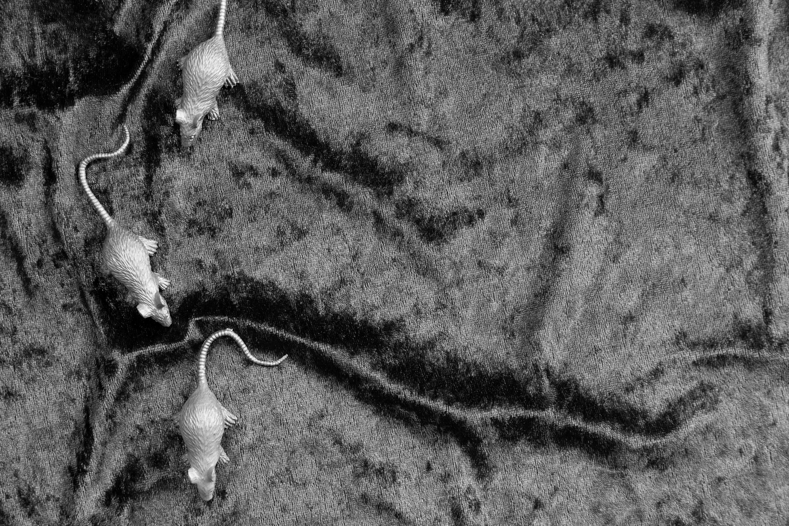
Mouthguards have evolved
Images reveal large amounts of data, so remember: use an image instead of a long text. Your audience will appreciate it

Slide 21
03
Numbers
You can enter a subtitle here if you need it

Slide 22
75+ mill.
It is estimated that this is the number of people who died from the Black Death

Slide 23
7
30%
3248
The minimum fatality rate per case when bubonic plague is not treated
These are the approximate days in which the symptoms appear
Global cases of the bubonic plague detected between 2010 and 2015

Slide 24
Some percentages of the Black Death
30%
10%
60%
Neptune
Venus
Mercury
Neptune is the fourth-largest planet in the Solar System
Venus has a beautiful name and is the second planet from the Sun
Mercury is the closest planet to the Sun and the smallest of them all

Slide 25
Learn more on our website

Slide 26
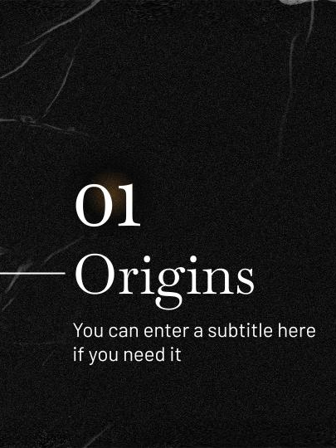
Interactive information on your tablet
You can replace the image on the screen with your own work. Just right-click on it and select “Replace image”

Slide 27
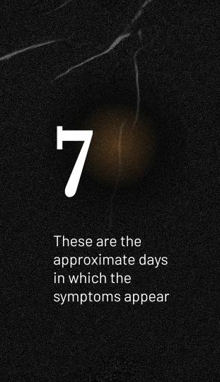
Download the app and keep on learning
You can replace the image on the screen with your own work. Just right-click on it and select “Replace image”

Slide 28
Most affected continents
Europe
Venus is the second planet from the Sun
Asia
Mercury is the closest planet to the Sun

Slide 29
History of the Black Death
1xxx
1xxx
1xxx
1xxx
Earth
Mars
Venus
Saturn
Earth is the planet with life
Mars is full of iron oxide dust
Mercury is quite a small planet
Saturn has several rings

Slide 30
Black Death process
Black Death
Mercury
Venus
Mars
Mercury is the closest planet to the Sun and the smallest of them all
Venus has a beautiful name and is the second planet from the Sun
Despite being red, Mars is actually a cold place. It’s full of iron oxide dust

Slide 31
Home remedies for the Black Death
Remedy 1 | Earth is the third planet from the Sun and the only one that harbors life in the Solar System. We all live on it
Remedy 2 | Despite being red, Mars is actually a cold place. It's full of iron oxide dust, which gives the planet its reddish cast
Remedy 3 | Jupiter is a gas giant and the biggest planet in the Solar System. It's the fourth-brightest object in the night sky
Remedy 4 | Neptune is the farthest planet from the Sun. It's also the fourth-largest planet by diameter in the Solar System

Slide 32
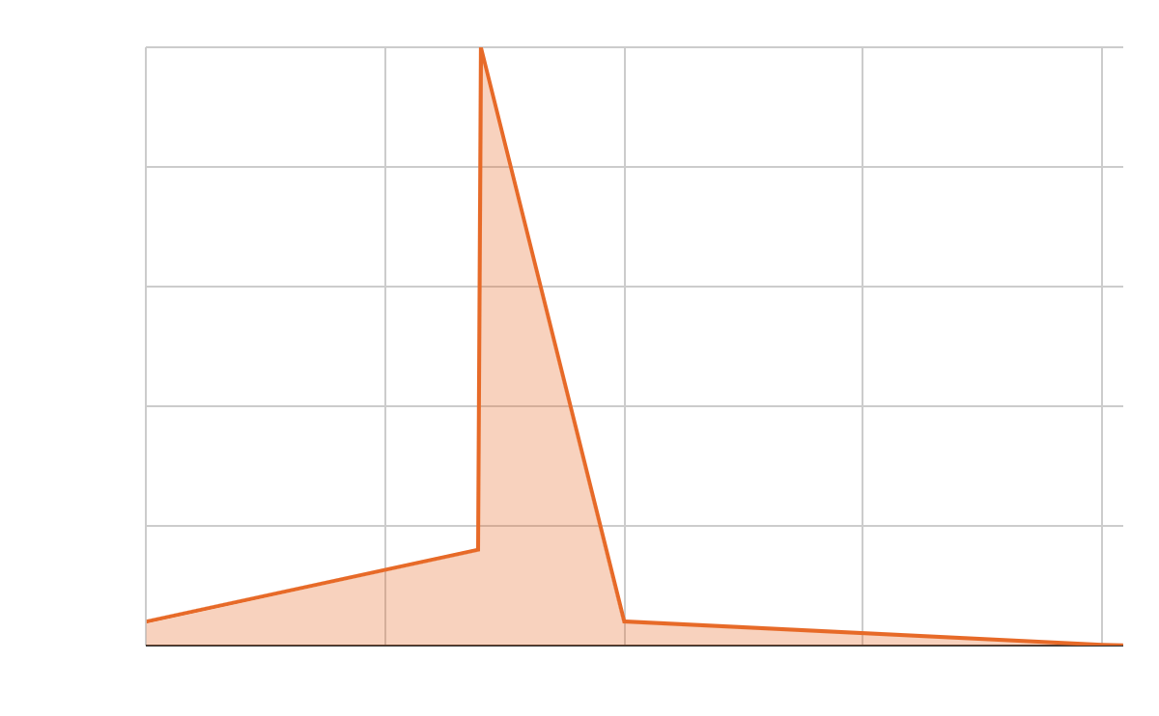
Elimination of Black Death
Deaths in millions
Saturn is a gas giant and has several rings. It's composed mostly of hydrogen and helium. It was named after the Roman god of wealth and agriculture
Follow the link in the graph to modify its data and then paste the new one here. For more info, click here

Slide 33
Preventive methods
Mercury
Mercury is quite a small planet
Earth
Earth is the planet with life
Venus
Venus has a beautiful name
Pluto
Pluto is now a dwarf planet
Mars
Mars is full of iron oxide dust
Neptune
Neptune is far away from us

Slide 34


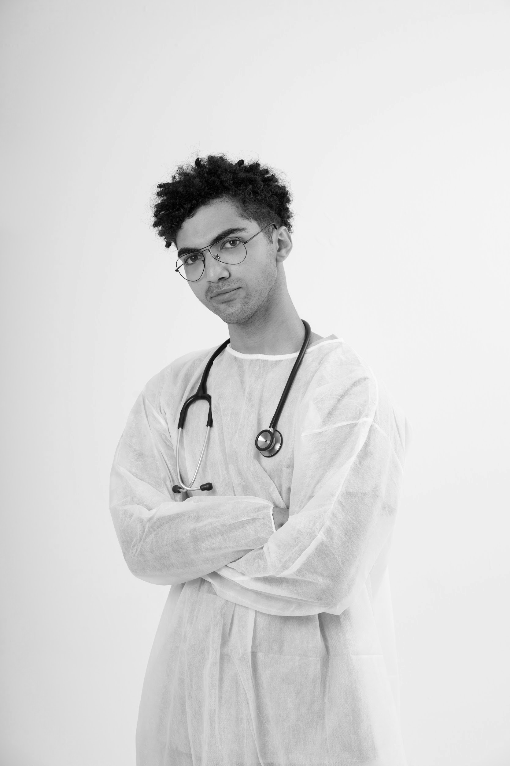
Our team
Dr. Jenna Doe
You can speak a bit about this person here
Dr. Samantha Jones
You can speak a bit about this person here
Dr. Timmy Jimmy
You can speak a bit about this person here

Slide 35
Conclusions
Venus has a beautiful name and is the second planet from the Sun. It’s terribly hot, even hotter than Mercury, and its atmosphere is extremely poisonous. It’s the second-brightest natural object in the night sky after the Moon

Slide 36
Thanks!
Do you have any questions?
youremail@freepik.com | +34 654 321 432 | yourwebsite.com
Please keep this slide for attribution

Slide 37
Icon pack

Slide 38






Alternative resources
Here’s an assortment of alternative resources whose style fits that of this template:
Vectors
Sign mockup with natural marble effect

Slide 39
Resources
Did you like the resources on this template? Get them for free at our other websites:
Photos
Flat lay rat figurines turquoise velvet
Side view man wearing protective equipment
Front view smiley doctor with lab coat
Doctor wearing white coat medium shot
Medium shot doctor wearing medical gown
Icons
Icon Pack: Medieval | Filled
Vectors
Music album release youtube cover

